Slide 1

Advanced Persistent Threats
UFCD 5745
Manuela Laranjeira
13 Janeiro 2023
Andreia Pereira & João R. Costa
Notes:
For today's presentation, we're going to discuss Advanced Persistent Threats (or APT's, for short). We'll be using CrowdStrike as our main source of information, since it is a trusting source in threat investigation.

Slide 2

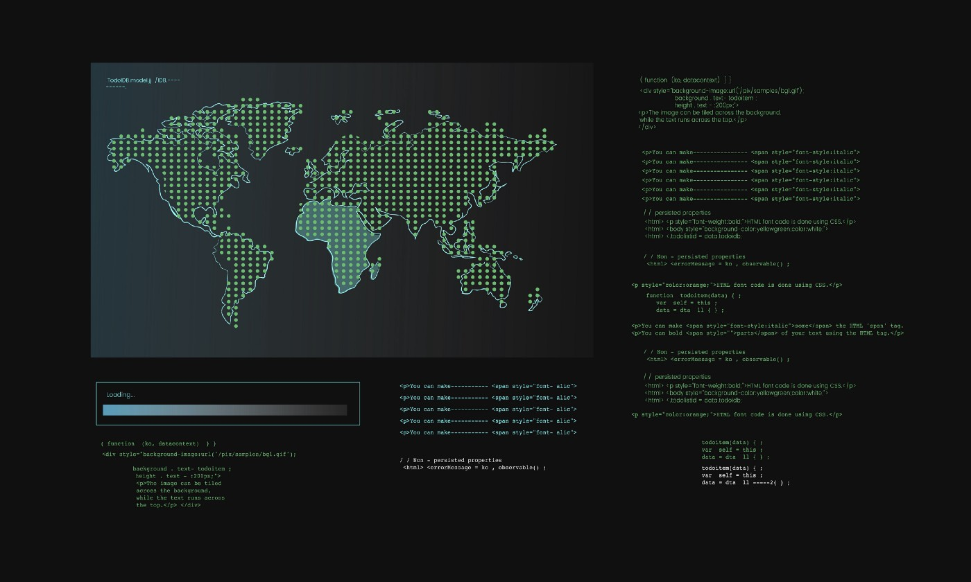
Objetives
What are APTs
Caracteristics
Kill chain
How to Avoid Them
Examples
Top 10 Adversaries
Notes:
Our goal is to give more insight into this often misunderstood topic. As such, we'll be going over what an APT is, how to identify one, what common methods they use to attack their targets and how we can protect ourselves against such gigantic threats. We will also be providing some examples of notable APT attacks and to finish off, we'll be taking a look at the top 10 adversaries of 2022, including what groups we should be aware of going into 2023 in specific countries, including Portugal

Slide 3

APT DEFINITION

Slide 4

Definition
Advanced
Type of attacks
Knowledge
Persistent
Keep trying
Patient
Threat
Has a motive
Well funded
Notes:
An Advanced Persistent Threat is a sustained cyberattack in which the intruder hides inside the victim's network in order to steal sensitive data.
Advanced:
These types of attacks tend to be targeted at high-value organizations (such as Fortune 500 companies and governmental agencies)
The attackers have the hability to write their own exploits, chaining together multiple zero-days in a single attack, creating sophisticated attack techniques and exploits in a creative way
Persistent:
Attacker will keep trying until he succeeds, while it is
Able to distinguish between short and long term gains; usually picking the latter to maintain their control and deepen it within the system.
Threats:
These are focused attacks, orchestrated by a large organization or a well funded group, and they are often performed by nation-state threat actors, composed of teams of the best cybercriminals in their particular countries.

Slide 5

Goals
Espionage
Social-political
Financial gain
Destruction
Notes:
You might be wondering: "What is the goal of these attacks?" - Well, there's a couple reasons why an APT attack might take place:
Espionage, like spying on another country to find out state secrets
Financial gain (This is quite common specifically for North Korean groups)
Socio-political reasons, such as fighting against dictatorships and internet censorship
Just plain destruction

Slide 6
Kill Chain

Slide 7

Stages
Infiltration
Escalation
Exfiltration
Notes:
Although there is a more intricate "Kill Chain", APT attacks usually consist of 3 stages:
Infiltration, where the attackers will try everything to get inside their target's network. This includes using multiple types of Social Engineering attacks, like phishing through all possible methods of communication.
Escalation, in which the attacks spread malware through the network and use that as a queue to expand, as a use to map the network and attempt to gather important credentials - like Administrator privileges - along the way. At this stage, they usually install multiple backdoors. In other words, many ways to get back into the network to perform more operations.
And exfiltration, where the attacks actually take the data they have gathered and extract it, while trying to not get detected. It usually involves distracting the target's security team and systems with something else, like a DoS (Denial of Service) attack, or even a "fake backdoor" being suddently exposed.

